Slide 1

Gender Inequality in the Law
An exploration of the WBL Index from 1970-2020
An exploration by: Abhijeet Sant
Notes:
Tableau Workbook link for additional insights: https://public.tableau.com/profile/abhijeet2052#!/vizhome/EconomicEmpowermentofWomen_16038323899870/Dashboard

Slide 2









WBL Indicators
Mobility
Parenthood
Workplace
Entrepreneurship
Pay
Assets
Marriage
Pension
Source: https://wbl.worldbank.org/
Notes:
What is the WBL and the WBL Index?
Women, Business and the Law (WBL) is a World Bank Group project collecting data on the laws and regulations that restrict women's economic opportunities. The available data that we will review tonight is for the period from 1970 to 2019
The index itself covers 190 economies and eight topics relevant to women's economic participation
Thirty-five aspects of the law are scored across the eight indicators of four or five binary questions (yes/no). Each indicator is a thematic representation of different phases of a woman’s career.
As an example, Mobility is based off of the following questions:
Can a woman choose where to live in the same way as a man?
Can a woman travel outside her home in the same way as a man?
Can a woman apply for a passport in the same way as a man?
Can a woman travel outside the country in the same way as a man?
Indicator-level scores are obtained by calculating the unweighted average of the questions within that indicator and scaling the result to 100. Overall scores are then calculated by taking the average of each indicator, with 100 representing the highest possible score

Slide 3
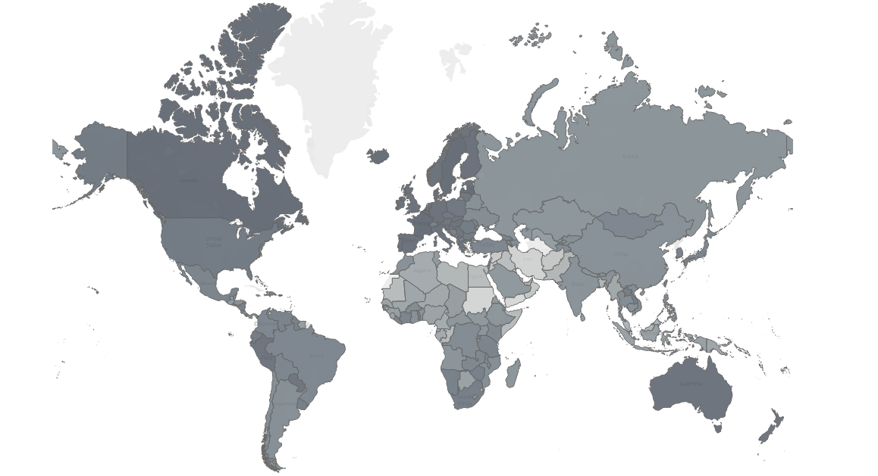
2020 World View
Avg. WBL score in 2020 was 75, +63% from 46 in 1971
OECD countries outpace others with an avg. score of 95 in 2019
18% of the world’s countries, mostly concentrated in Africa and the Middle East, have WBL scores below avg.
Notes:
On this slide you will see each country shaded based on the relative strength of their score on a scale of 0 to 100.
In 2020, the average score was 75, up from 46 in 1971.
While the index itself has improved overall, there are still areas of opportunity to improve as reflected in the gap among developed vs. developing nations.
OECD countries scored an average of 95, whereas 18% of the world scored below the global average of 75, and are mostly concentrated in Africa and the Middle East.
Can anyone take a guess, based on the map, what the WBL Index score of the United States is? In 2020, it is 91 up from 67 in 1971.

Slide 4

Motivating Question
Which indicators need improvement?
Notes:
Based on the information covered already, we want to drill in to identify what areas of the index to focus on for improvement.
We will do so by first looking at the countries that have improved their scores the most since 1971.

Slide 5
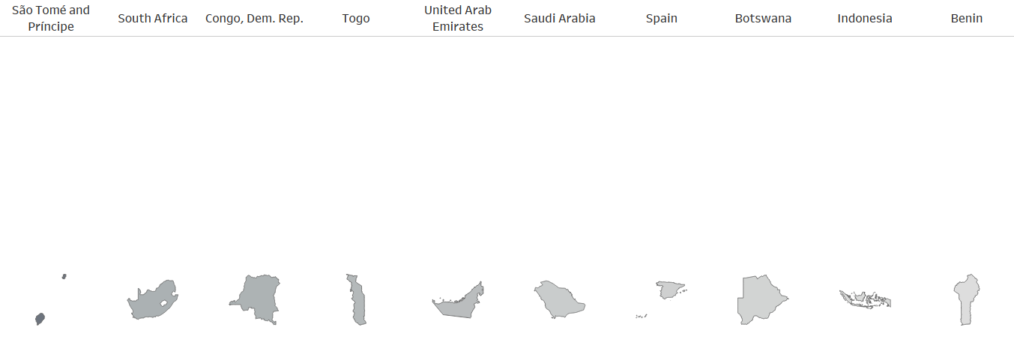
Most Improved Countries
The below countries have shown the greatest increases in their WBL score since 1971
+359%
+244%
+241%
+230%
+222%
+197%
+188%
+184%
+171%
+165%
Notes:
These are the countries with the greatest percentage increase in their WBL Index from 1971 to 2020.
For the purposes of our analysis, we will drill into South Africa as it is a country that has improved significantly at +244% but does have more work to do at 88 out of 100. Additionally, it is an outlier compared to the relatively slow scores in other African countries as seen on the World View slide.

Slide 6
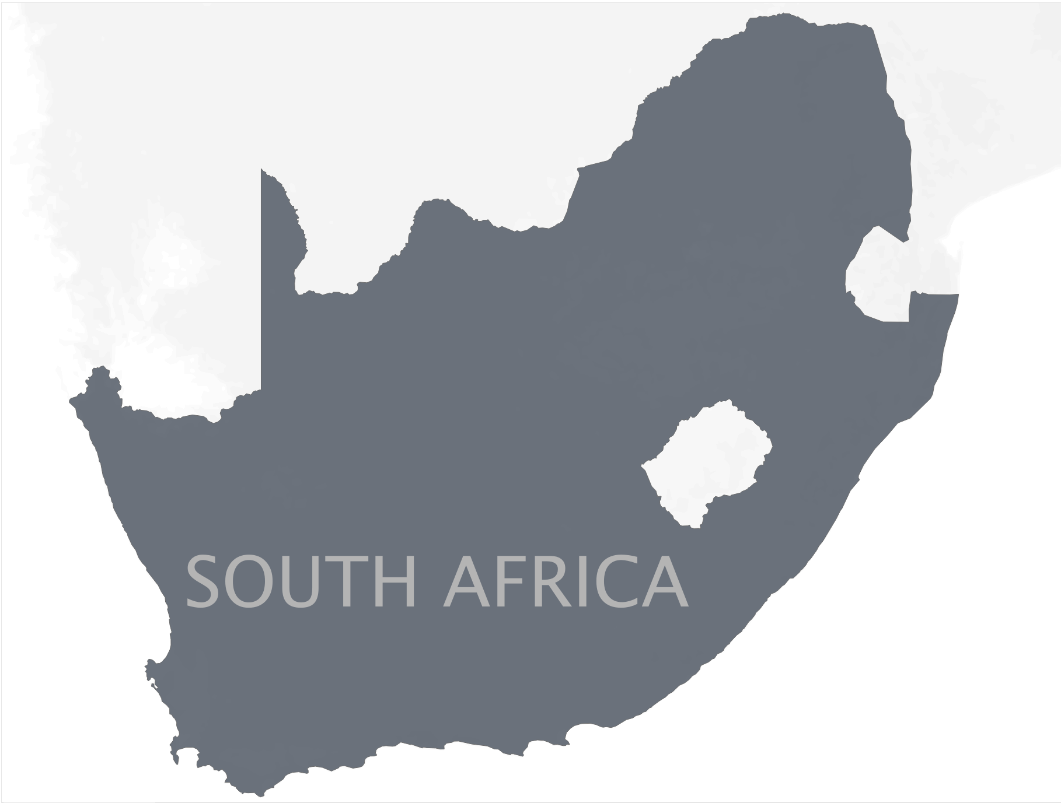
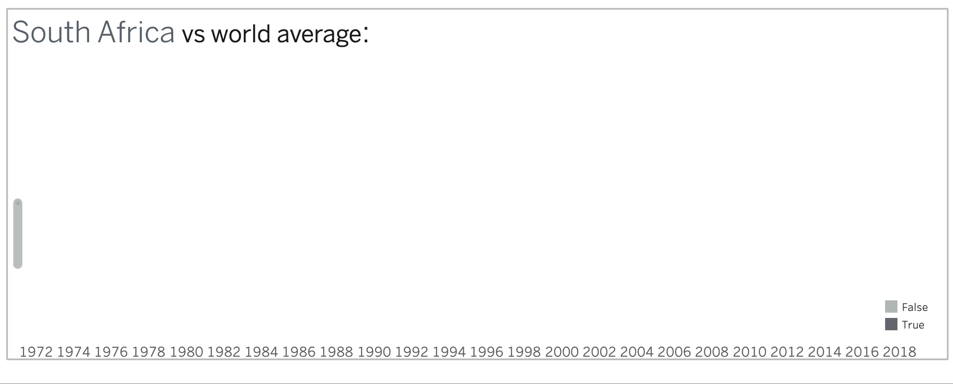
A closer look at South Africa
Ranked 47th in 2020 with a clear improvement in trend with the end of apartheid in the early 1990s
Notes:
*Play animation*
As you can see, South Africa’s score was below the world average from 1971 up until the early 1990s with the end of Apartheid.
Currently, they are ranked 47th and have consistently trended upward.

Slide 7
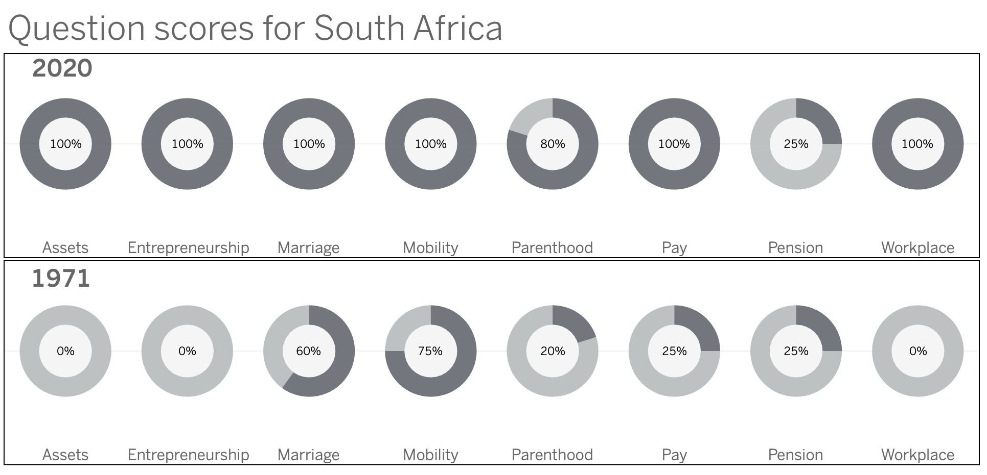
A closer look at South Africa
Improvement in 7/8
indicators from 1971-2020
Notes:
Taking a step deeper into South Africa’s score, we can see improvement in 7 of 8 questions since 1971, with Parenthood and Pension the only non-100 scores.

Slide 8
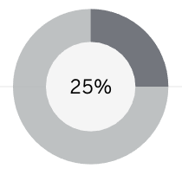
A closer look at South Africa
1971
2020
Improvement in 7/8
indicators from 1971-2020
With no change in Pension, there is work to be done here
Notes:
As you can see, there was no change in South Africa’s pension score which covers the questions:
Are the ages at which men and women can retire with full pension benefits equal?
Are the ages at which men and women can retire with partial benefits equal?
Is the mandatory retirement age for men and women equal? This is the only affirmative question.
Are periods of absence due to childcare accounted for in pension benefits?

Slide 9
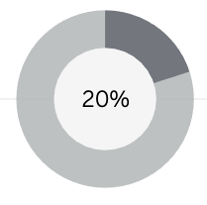
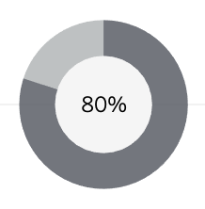
A closer look at South Africa
1971
2020
Improvement in 7/8
indicators from 1971-2020
Despite growth in Parenthood, there is still opportunity
Notes:
As we look at Parenthood, their score jumped from 20% to 80%, with the breakdown as follows:
Is paid leave of at least 14 weeks available to mothers?
Does the government administer 100% of maternity leave benefits? The only affirmative in 1971
Is there paid leave available to fathers?
Is there paid parental leave? Only remaining negative answer.
Is dismissal of pregnant workers prohibited?

Slide 10

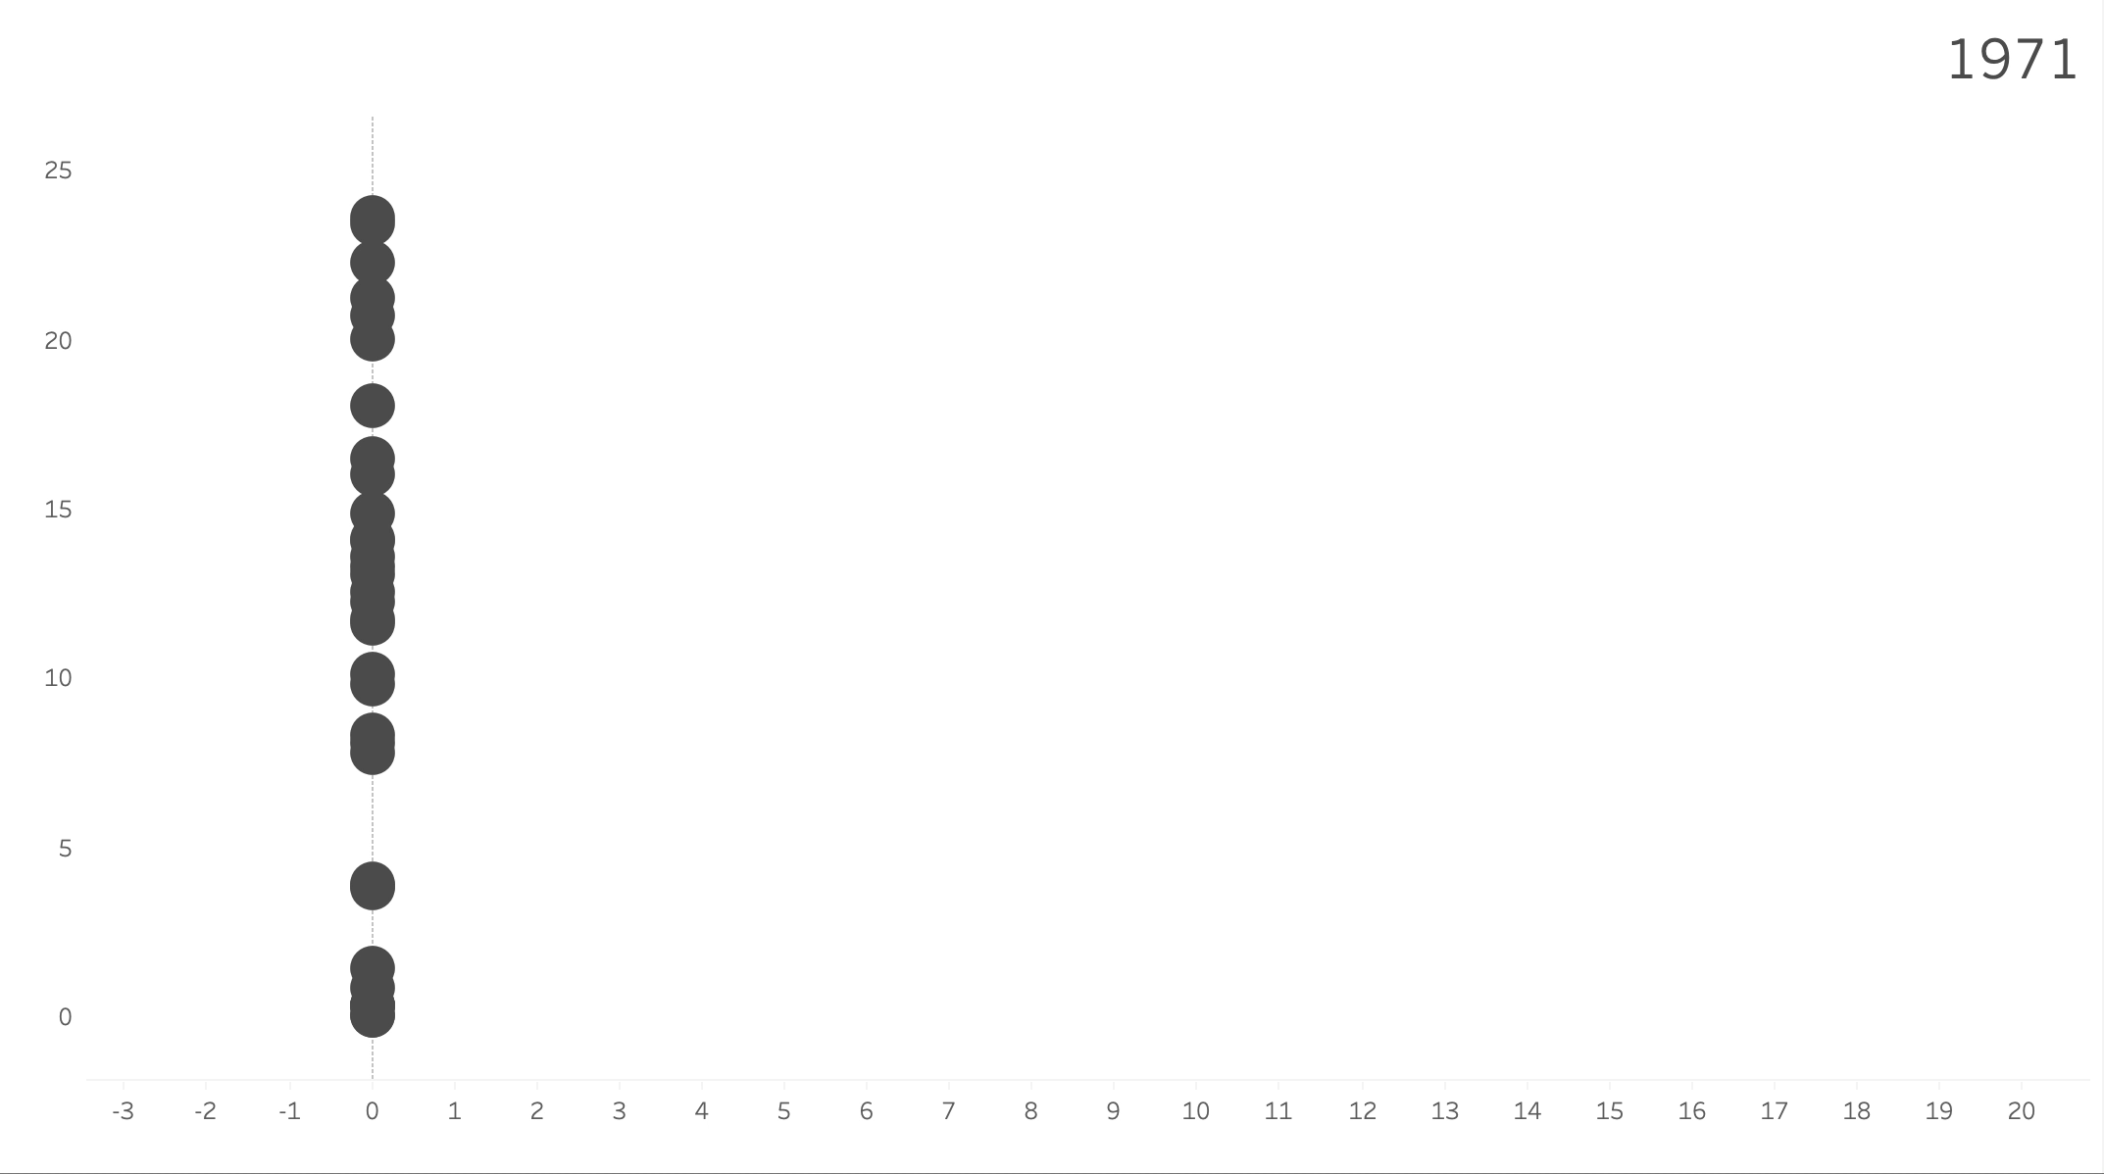
WBL Indicators - Worldwide
Out of all the indicators, WORKPLACE has shown the most progress since 1971
Notes:
“Play Animation”
Now, let’s take a step back and look at the WBL indicators across the world and how they progressed since 1971.
To note, the x-axis in this animation represents the average score on the question, with the y-axis representing the change from 1971. You’ll notice all
Based on the areas of improvement and stagnation, we view South Africa as a good representative of the progress made by the world at large. Specifically, highlighting the pension score which is the only negative and parenthood which is the lowest overall.

Slide 11
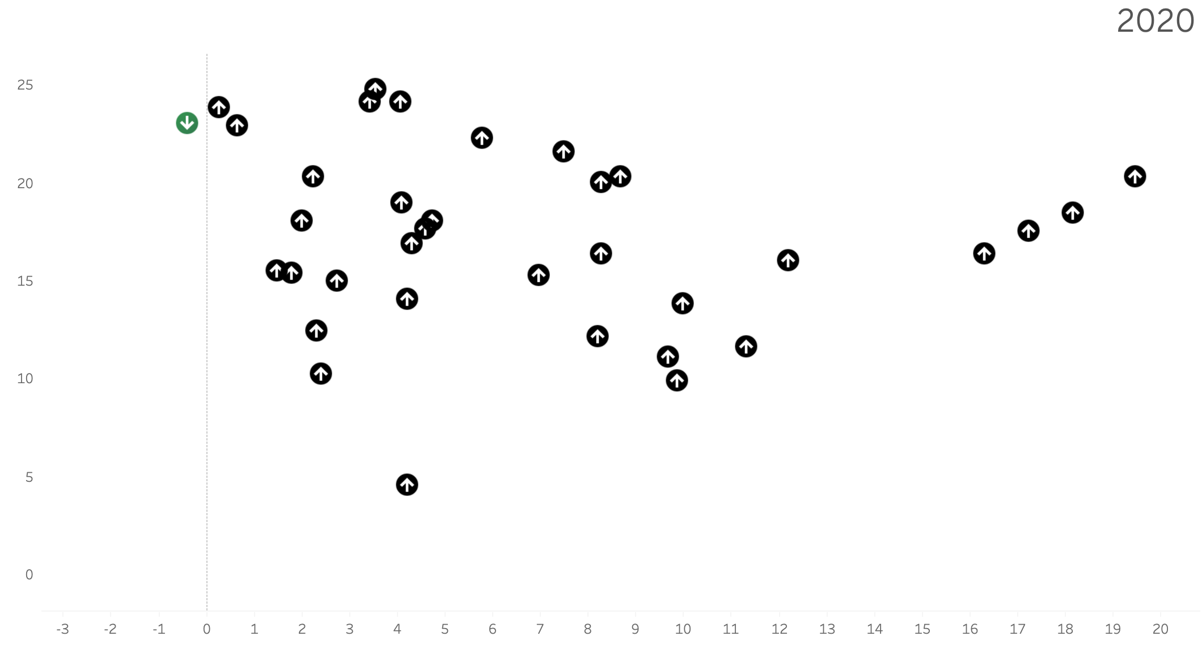
WBL Index - Worldwide
Pension: Is the mandatory retirement age for men and women equal?
Statistics:
1971 score: 23.42
2020 score: 23.03 , which is a -0.39-point decrease from the 1971 score.
Notes:
Looking at the specific score for whether the mandatory retirement age for men and women is equal, the score ticked down slightly from 1971: 23.42 to 23.03.

Slide 12
WBL Index - Worldwide
Parenthood: Is there paid parental leave?
Statistics:
1971 score: 0.32
2020 score: 4.53 , which is a +4.21-point increase from the 1971 score.
Notes:
Looking now at the Parenthood question on whether there is paid parental leave, you can see overall this has increased from .32 to 4.53 since 1971 and represents another area of improvement, especially for South Africa where this is the only remaining negative response.

Slide 13
Call to action
More focus needed on Parenthood and Pension
Notes:
Based on the data we have reviewed, using South Africa as an example, we believe there should be a concentrated focus on the improvements to the Parenthood questions as well as Pension. By doing so, we believe we will see an improvement to the overall global average WBL scores, and most importantly, the economic standing of women across the globe.

